Slide 1
The Course
Image representation
Image statistics
Histograms (frequency)
Entropy (information)
Filters (low, high, edge, smooth)
Books
  Computer Vision – Adrian Lowe
  Digital Image Processing – Gonzalez, Woods
  Image Processing, Analysis and Machine Vision – Milan Sonka, Roger Boyle
Notes:
given by Jason last year it is fundamentally the same as last year with some small alterations to siut me.
The books are not in any particular order.

Slide 2
Digital Image Processing
Human vision - perceive and understand world
Computer vision, Image Understanding / Interpretation, Image processing.
  3D world -> sensors (TV cameras) -> 2D images
  Dimension reduction -> loss of information
low level image processing
    transform of one image to another
high level image understanding
    knowledge based - imitate human cognition
    make decisions according to information in image
Notes:
Computer vision some times called machine vision, is application driven and does not always attempt to model the HVS.
Image understanding / interpretation aim to extract the semantic information from the image / video.
There are two different types of information in an image:
Cognitive which is the storey line the human interpreted info
Formative which is the mathematical signal that exists

Slide 3
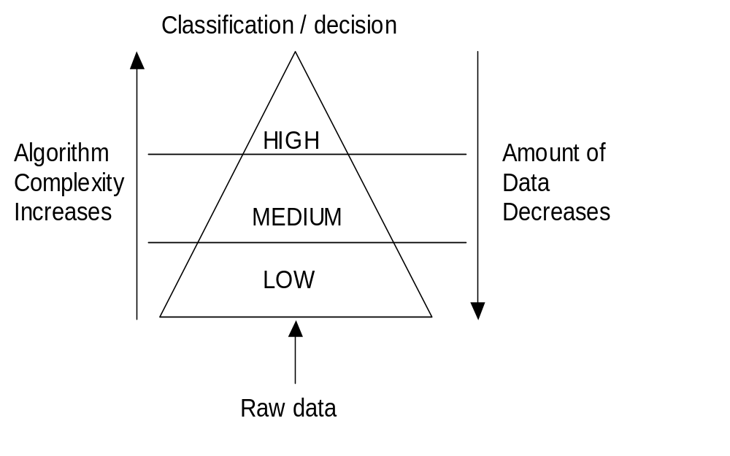
Introduction to Digital Image Processing
Acquisition, preprocessing
  no intelligence
Extraction, edge joining
Recognition, interpretation
  intelligent

Slide 4
Low level digital image processing
Low level computer vision ~ digital image processing
Image Acquisition
  image captured by a sensor (TV camera) and digitized
Preprocessing
  suppresses noise (image pre-processing)
  enhances some object features - relevant to understanding the image
  edge extraction, smoothing, thresholding etc.
Image segmentation
  separate objects from the image background
  colour segmentation, region growing, edge linking etc
Object description and classification
  after segmentation
Notes:
This course is primarily concerned with the Pre-processing of an image.

Slide 5
Signals and Functions
What is an image
Signal = function (variable with physical meaning)
  one-dimensional (e.g. dependent on time)
  two-dimensional (e.g. images dependent on two co-ordinates in a plane)
  three-dimensional (e.g. describing an object in space)
  higher-dimensional
Scalar functions
  sufficient to describe a monochromatic image - intensity images
Vector functions
  represent color images - three component colors
Notes:
In general an image is a signal and as with all signals they are functions of physical things.
Acoustic analogy is that it is the pressure waves in time that are sensed by the microphone.

Slide 6
Image Functions
Image - continuous function of a number of variables
Co-ordinates x, y in a spatial plane
  for image sequences - variable (time) t
Image function value = brightness at image points
  other physical quantities
  temperature, pressure distribution, distance from the observer
Image on the human eye retina / TV camera sensor - intrinsically 2D
2D image using brightness points = intensity image
Mapping 3D real world -> 2D image
  2D intensity image = perspective projection of the 3D scene
  information lost - transformation is not one-to-one
  geometric problem - information recovery
  understanding brightness info
Notes:
Image functions are specifically
Sketch time course of images.

Slide 7
Image Acquisition & Manipulation
Analogue camera
  frame grabber
  video capture card
Digital camera / video recorder
Capture rate → 30 frames / second
  HVS persistence of vision
Computer, digitised image, software (usually c)
f(x,y) → #define M 128
#define N 128
unsigned char f[N][M]
2D array of size N*M
Each element contains an intensity value

Slide 8
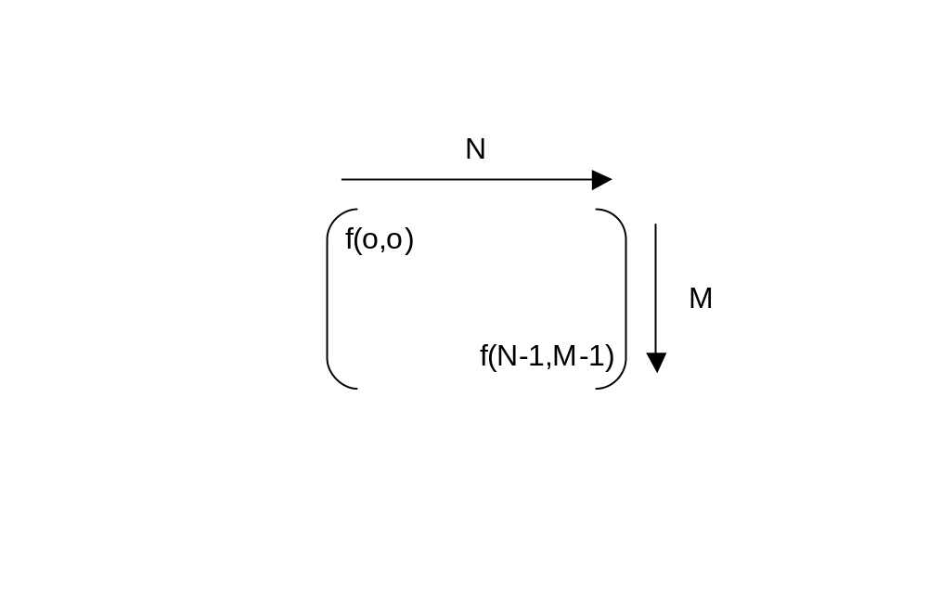

Image definition
Image definition:
  A 2D function obtained by sensing a scene
  F(x,y), F(x₁,x₂), F(x)
  F - intensity, grey level
  x,y - spatial co-ordinates
No. of grey levels, L = 2^{B}
B = no. of bits
Notes:
Typical 256 levels because it a bite I.ie 8 bits

Slide 9
Brightness and 2D images
Brightness dependent several factors
  object surface reflectance properties
    surface material, microstructure and marking
  illumination properties
  object surface orientation with respect to a viewer and light source
Some Scientific / technical disciplines work with 2D images directly
  image of flat specimen viewed by a microscope with transparent illumination
  character drawn on a sheet of paper
  image of a fingerprint
Notes:
Illumination properties - e.g. provide their own light as in glow in the dark stickers

Slide 10
Monochromatic images
Image processing - static images - time t is constant
Monochromatic static image - continuous image function f(x,y)
  arguments - two co-ordinates (x,y)
Digital image functions - represented by matrices
  co-ordinates = integer numbers
  Cartesian (horizontal x axis, vertical y axis)
  OR (row, column) matrices
Monochromatic image function range
  lowest value - black
  highest value - white
Limited brightness values = gray levels
Notes:
This course is primarily concerned with monochromatic images because is easier to learn with rather than confusing things with vectors.

Slide 11

Chromatic images
Colour
  Represented by vector not scalar
    Red, Green, Blue (RGB)
    Hue, Saturation, Value (HSV)
    luminance, chrominance (Yuv , Luv)
S=0
Green
Hue degrees:
Red, 0 deg
Green 120 deg
Blue 240 deg
Red
Green
V=0

Slide 12
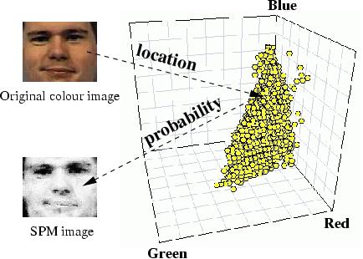
Use of colour space

Slide 13
Image quality
Quality of digital image proportional to:
  spatial resolution
    proximity of image samples in image plane
  spectral resolution
    bandwidth of light frequencies captured by sensor
  radiometric resolution
    number of distinguishable gray levels
  time resolution
    interval between time samples at which images captured

Slide 14
Image summary
F(x_{i},y_{j})
i = 0 --> N-1
j = 0 --> M-1
N*M = spatial resolution, size of image
L = intensity levels, grey levels
B = no. of bits

Slide 15
Digital Image Storage
Stored in two parts
  header
    width, height … cookie.
      Cookie is an indicator of what type of image file
  data
    uncompressed, compressed, ascii, binary.
File types
  JPEG, BMP, PPM.

Slide 16
PPM, Portable Pixel Map
Cookie
  Px
    Where x is:
    1 - (ascii) binary image (black & white, 0 & 1)
    2 - (ascii) grey-scale image (monochromic)
    3 - (ascii) colour (RGB)
    4 - (binary) binary image
    5 - (binary) grey-scale image (monochromatic)
    6 - (binary) colour (RGB)
Notes:
To help with understanding of systems and software design with images.

Slide 17
PPM example
PPM colour file RGB
P3
# feep.ppm
4 4
15
0 0 0 0 0 0 0 0 0 15 0 15
0 0 0 0 15 7 0 0 0 0 0 0
0 0 0 0 0 0 0 15 7 0 0 0
15 0 15 0 0 0 0 0 0 0 0 0

Slide 18
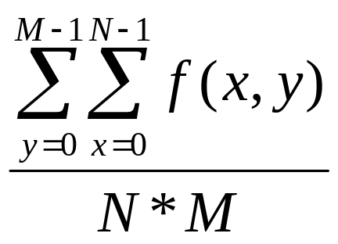
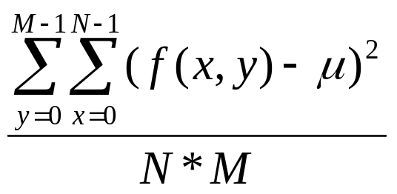
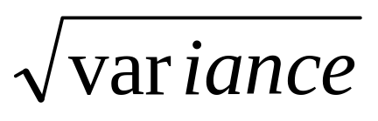
Image statistics
MEAN μ =
VARIANCE σ² =
STANDARDEVIATION σ =

Slide 19
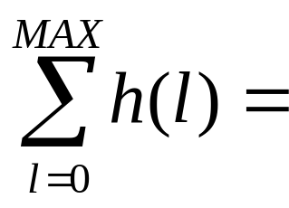
Histograms, h(l)
Counts the number of occurrences of each grey level in an image
l = 0,1,2,… L-1
l = grey level, intensity level
L = maximum grey level, typically 256
Area under histogram
Total number of pixels N*M
  unimodal, bimodal, multi-modal, dark, light, low contrast, high contrast

Slide 20
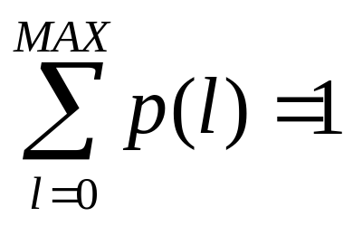
Probability Density Functions, p(l)
Limits 0 < p(l) < 1
p(l) = h(l) / n
n = N*M (total number of pixels)

Slide 21
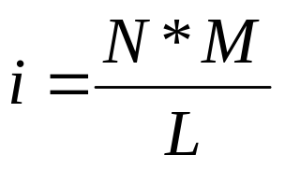
Histogram Equalisation, E(l)
Increases dynamic range of an image
Enhances contrast of image to cover all possible grey levels
Ideal histogram = flat
  same no. of pixels at each grey level
Ideal no. of pixels at each grey level =

Slide 22
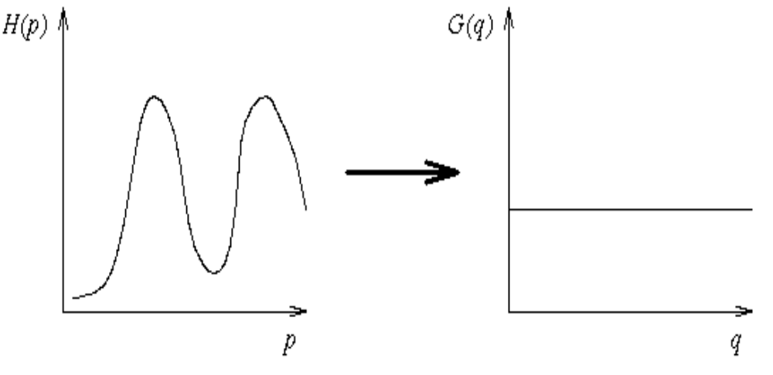
Histogram equalisation
Typical histogram
Ideal histogram

Slide 23
E(l) Algorithm
Allocate pixel with lowest grey level in old image to 0 in new image
If new grey level 0 has less than ideal no. of pixels, allocate pixels at next lowest grey level in old image also to grey level 0 in new image
When grey level 0 in new image has > ideal no. of pixels move up to next grey level and use same algorithm
Start with any unallocated pixels that have the lowest grey level in the old image
If earlier allocation of pixels already gives grey level 0 in new image TWICE its fair share of pixels, it means it has also used up its quota for grey level 1 in new image
Therefore, ignore new grey level one and start at grey level 2 …..

Slide 24
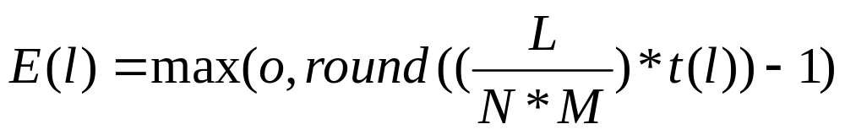
Simplified Formula
E(l) → equalised function
max → maximum dynamic range
round → round to the nearest integer (up or down)
L → no. of grey levels
N*M → size of image
t(l) → accumulated frequencies

Slide 25
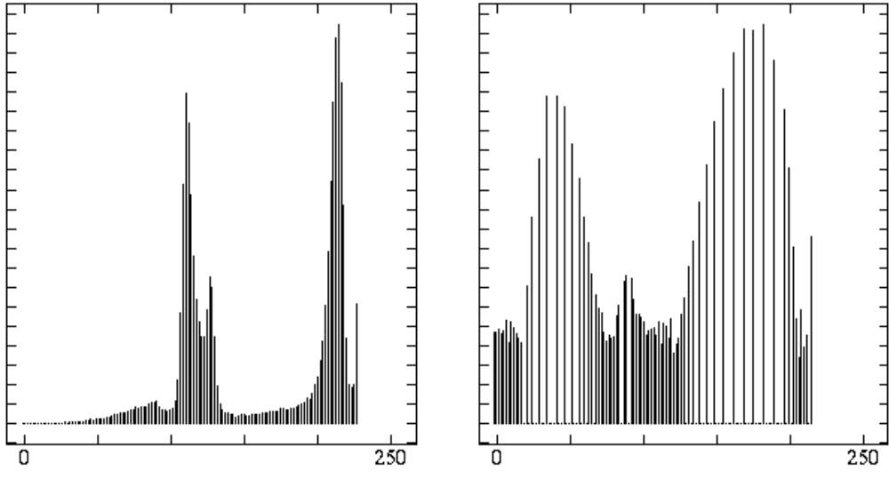
Histogram equalisation examples
Typical histogram
After histogram equalisation

Slide 26
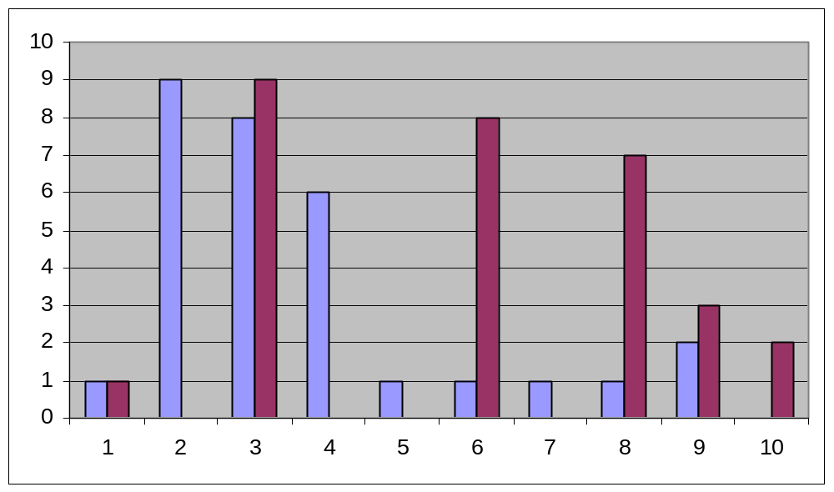
Histogram Equalisation e.g.
Before HE
After HE
Ideal=3

Slide 27
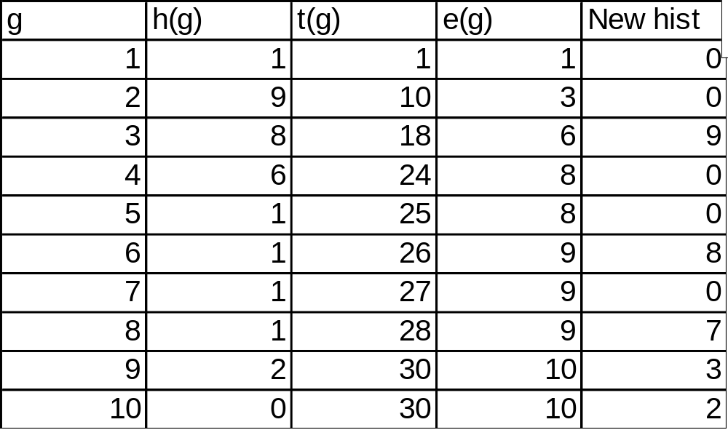

Slide 28
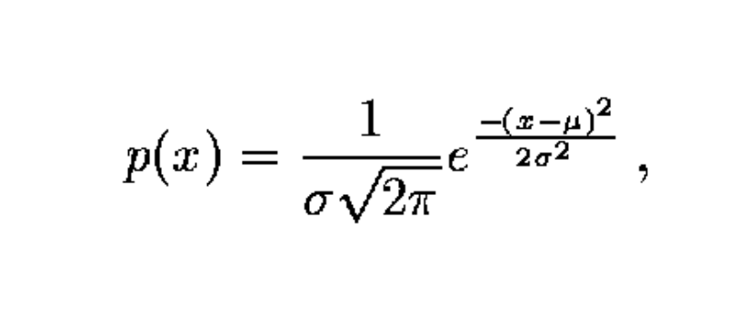
Noise in images
Images often degraded by random noise
  image capture, transmission, processing
  dependent or independent of image content
White noise - constant power spectrum
  intensity does not decrease with increasing frequency
  very crude approximation of image noise
Gaussian noise
  good approximation of practical noise
Gaussian curve = probability density of random variable
  1D Gaussian noise - µ is the mean
  σ is the standard deviation

Slide 29
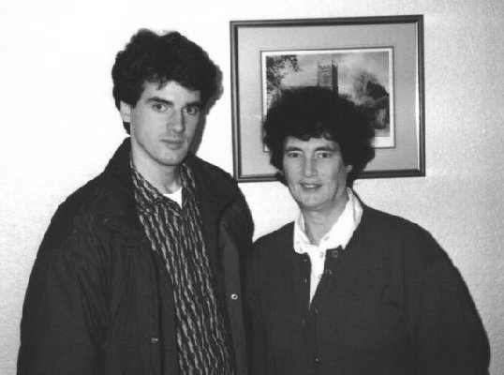
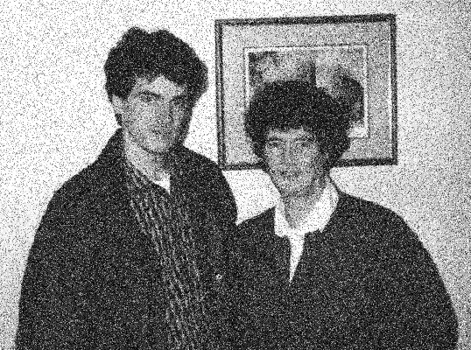
Gaussian noise e.g.
50% Gaussian noise

Slide 30
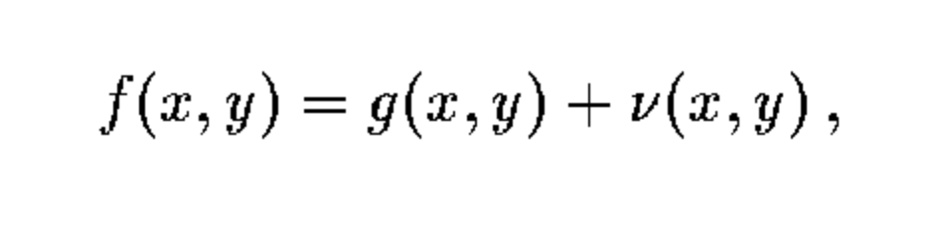
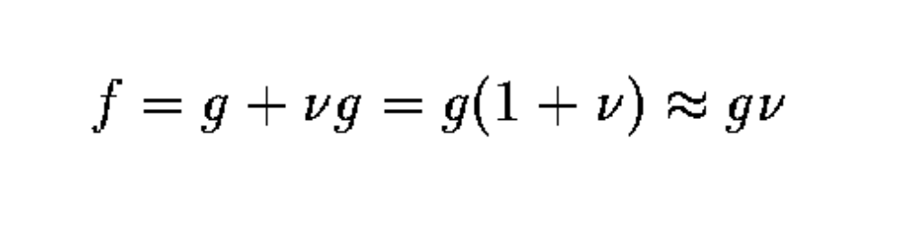
Types of noise
Image transmission
  noise usually independent image signal
additive, noise v and image signal g are independent
multiplicative, noise is a function of signal magnitude
impulse noise (saturated = salt and pepper noise)

Slide 31

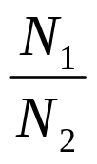
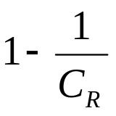
Data Information
Different quantities of data used to represent same information
  people who babble, succinct
Redundancy
  if a representation contains data that is not necessary
Compression ratio C_{R} =
Relative data redundancy R_{D} =

Slide 32
Types of redundancy
Coding
  if grey levels of image are coded in such away that uses more symbols than is necessary
Inter-pixel
  can guess the value of any pixel from its neighbours
Psyco-visual
  some information is less important than other info in normal visual processing
Data compression
  when one / all forms of redundancy are reduced / removed
  data is the means by which information is conveyed

Slide 33
Coding redundancy
Can use histograms to construct codes
Variable length coding reduces bits and gets rid of redundancy
Less bits to represent level with high probability
More bits to represent level with low probability
Takes advantage of probability of events
  Images made of regular shaped objects / predictable shape
  Objects larger than pixel elements
  Therefore certain grey levels are more probable than others
  i.e. histograms are NON-UNIFORM
Natural binary coding assigns same bits to all grey levels
Coding redundancy not minimised

Slide 34
Run length coding (RLC)
Represents strings of symbols in an image matrix
  FAX machines
  records only areas that belong to the object in the image
  area represented as a list of lists
Image row described by a sublist
  first element = row number
  subsequent terms are co-ordinate pairs
  first element of a pair is the beginning of a run
  second is the end
  can have several sequences in each row
Also used in multiple brightness images
  in sublist, sequence brightness also recorded

Slide 35
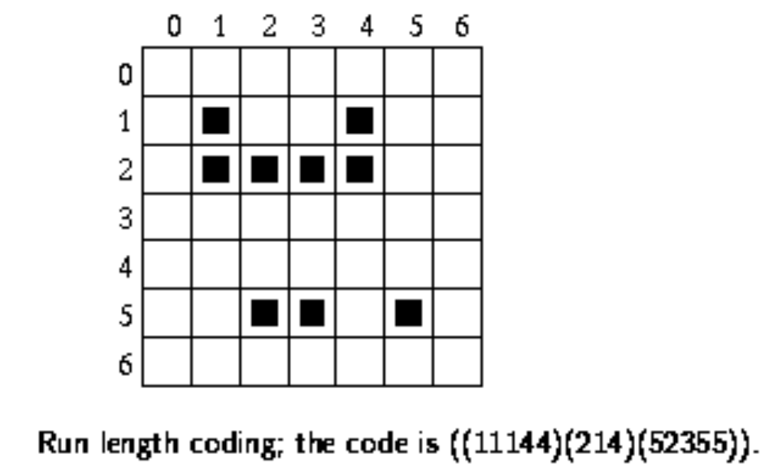
Example of RLC

Slide 36
Inter-pixel redundancy, IPR
Correlation between pixels is not used in coding
  Correlation due to geometry and structure
Value of any pixel can be predicted from the value of the neighbours
Information carried by one pixel is small
Take 2D visual information
  transformed → NONVISUAL format
This is called a MAPPING
A REVERSIBLE MAPPING allows original to be reconstructed after MAPPING
Use run-length coding

Slide 37
Psyco-visual redundancy, PVR
Due to properties of human eye
Eye does not respond with equal sensitivity to all visual information (e.g. RGB)
Certain information has less relative importance
If eliminated, quality of image is relatively unaffected
This is because HVS only sensitive to 64 levels
Use fidelity criteria to assess loss of information

Slide 38
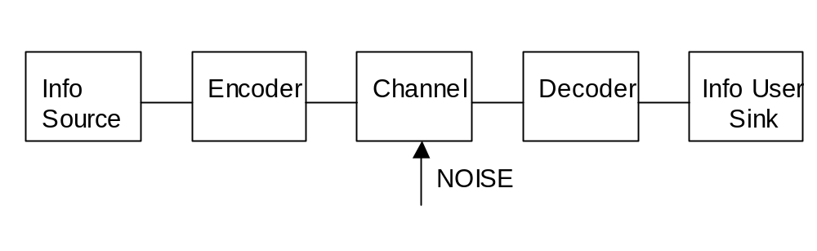
Fidelity Criteria
In a noiseless channel, the encoder is used to remove any redundancy
2 types of encoding
  LOSSLESS
  LOSSY
Design concerns
  Compression ratio, C_{R} achieved
  Quality achieved
  Trade off between C_{R} and quality
  PVR removed, image quality is reduced
  2 classes of criteria
    OBJECTIVE fidelity criteria
    SUBJECTIVE fidelity criteria
  OBJECTIVE: if loss is expressed as a function of IP / OP

Slide 39
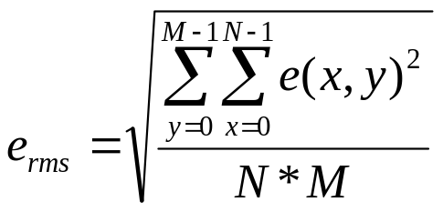
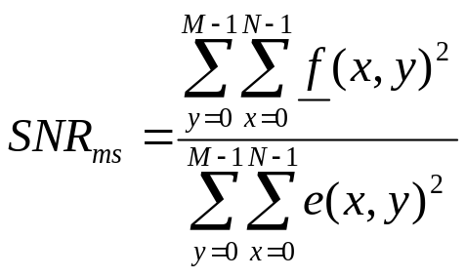
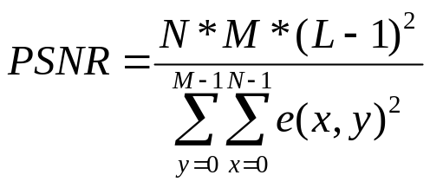
Fidelity Criteria
Input → f(x,y)
compressed output → f(x,y)
error → e(x,y) = f(x,y) -f(x,y)
e_{rms} = root mean squared error
SNR = signal to noise ratio
PSNR = peak signal to noise ratio

Slide 40
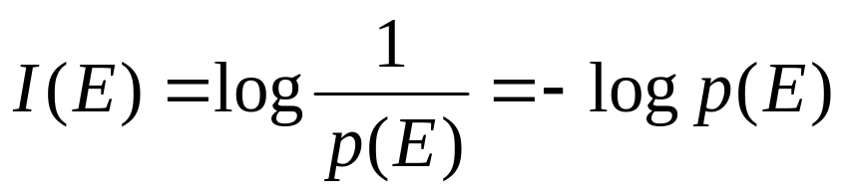
Information Theory
How few data are needed to represent an image without loss of info?
  Measuring information
    random event, E
    probability, p(E)
    units of information, I(E)
I(E) = self information of E
    amount of info is inversely proportional to the probability
    base of log is the unit of info
    log₂ = binary or bits
    e.g. p(E) = ½ => 1 bit of information (black and white)

Slide 41
Infromation channel
Connects source and user
  physical medium
Source generates random symbols from a closed set
Each source symbol has a probability of occurrence
Source output is a discrete random variable
Set of source symbols is the source alphabet

Slide 42
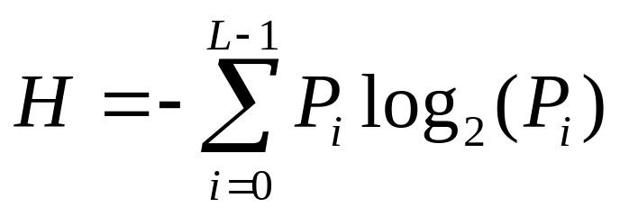
Entropy
Entropy is the uncertainty of the source
Probability of source emitting a symbol, S = p(S)
Self information I(S) = -log p(S)
For many S_{i} , i = 0, 1, 2, … L-1
Defines the average amount of info obtained by observing a single source output
OR average information per source output (bits)
  alphabet = 26 letters → 4.7 bits/letter
  typical grey scale = 256 levels → 8 bits/pixel

Slide 43
Filters
Need templates and convolution
Elementary image filters are used
  enhance certain features
  de-enhance others
  edge detect
  smooth out noise
  discover shapes in images
Convolution of Images
  essential for image processing
  template is an array of values
  placed step by step over image
  each element placement of template is associated with a pixel in the image
  can be centre OR top left of template

Slide 44
Template Convolution
Each element is multiplied with its corresponding grey level pixel in the image
The sum of the results across the whole template is regarded as a pixel grey level in the new image
CONVOLUTION --> shift add and multiply
Computationally expensive
  big templates, big images, big time!
M*M image, N*N template = M²N²

Slide 45
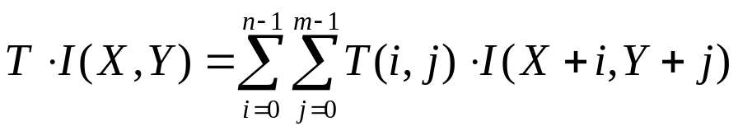
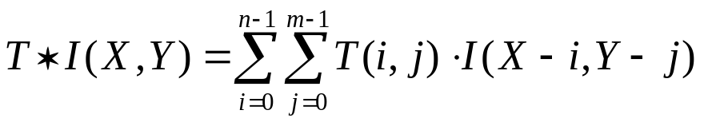
Convolution
Let T(x,y) = (n*m) template
Let I(X,,Y) = (N*M) image
Convolving T and I gives:
CROSS-CORRELATION not CONVOLUTION
Real convolution is:
convolution often used to mean cross-correlation

Slide 46
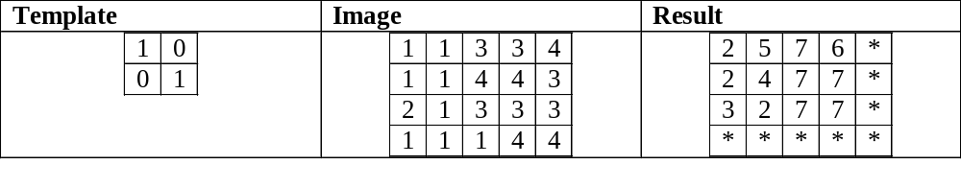
Templates
Template is not allowed to shift off end of image
Result is therefore smaller than image
2 possibilities
  pixel placed in top left position of new image
  pixel placed in centre of template (if there is one)
  top left is easier to program
Periodic Convolution
  wrap image around a ball
  template shifts off left, use right pixels
Aperiodic Convolution
  pad result with zeros
Result
  same size as original
  easier to program

Slide 47
Filters
Need templates and convolution
Elementary image filters are used
  enhance certain features
  de-enhance others
  edge detect
  smooth out noise
  discover shapes in images
Convolution of Images
  essential for image processing
  template is an array of values
  placed step by step over image
  each element placement of template is associated with a pixel in the image
  can be centre OR top left of template

Slide 48
Template Convolution
Each element is multiplied with its corresponding grey level pixel in the image
The sum of the results across the whole template is regarded as a pixel grey level in the new image
CONVOLUTION --> shift add and multiply
Computationally expensive
  big templates, big images, big time!
M*M image, N*N template = M²N²

Slide 49
Templates
Template is not allowed to shift off end of image
Result is therefore smaller than image
2 possibilities
  pixel placed in top left position of new image
  pixel placed in centre of template (if there is one)
  top left is easier to program
Periodic Convolution
  wrap image around a ball
  template shifts off left, use right pixels
Aperiodic Convolution
  pad result with zeros
Result
  same size as original
  easier to program

Slide 50


Low pass filters
Moving average of time series smoothes
Average (up/down, left/right)
  smoothes out sudden changes in pixel values
  removes noise
  introduces blurring
Classical 3x3 template
  Removes high frequency components
  Better filter, weights centre pixel more

Slide 51
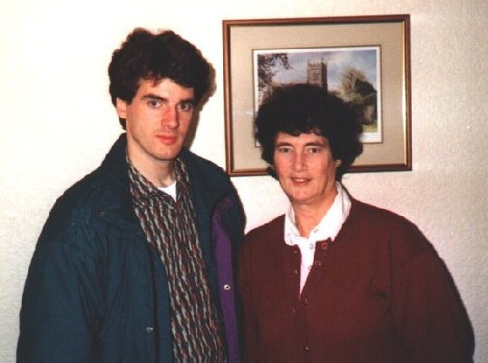

Example of Low Pass
Original
Gaussian, sigma=3.0

Slide 52
High pass filters
Removes gradual changes between pixels
  enhances sudden changes
  i.e. edges
Roberts Operators
  oldest operator
  easy to compute only 2x2 neighbourhood
  high sensitivity to noise
  few pixels used to calculate gradient

Slide 53


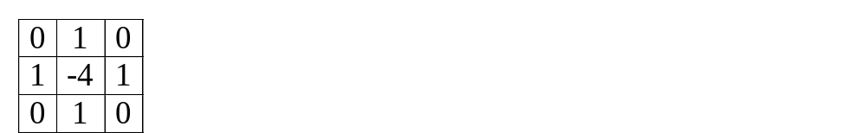


High pass filters
Laplacian Operator
  known as
  template sums to zero
  image is constant (no sudden changes), output is zero
  popular for computing second derivative
  gives gradient magnitude only
  usually a 3x3 matrix
  stress centre pixel more
  can respond doubly to some edges

Slide 54



Cont.
Prewitt Operator
  similar to Sobel, Kirsch, Robinson
  approximates the first derivative
  gradient is estimated in eight possible directions
  result with greatest magnitude is the gradient direction
  operators that calculate 1st derivative of image are known as COMPASS OPERATORS
  they determine gradient direction
  1st 3 masks are shown below (calculate others by rotation …)
  direction of gradient given by mask with max response

Slide 55





Cont.
Sobel
  good horizontal / vertical edge detector
Robinson
Kirsch

Slide 56
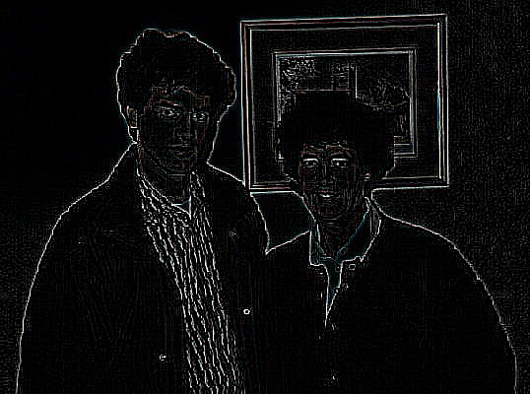
Example of High Pass
Laplacian Filter - 2nd derivative

Slide 57
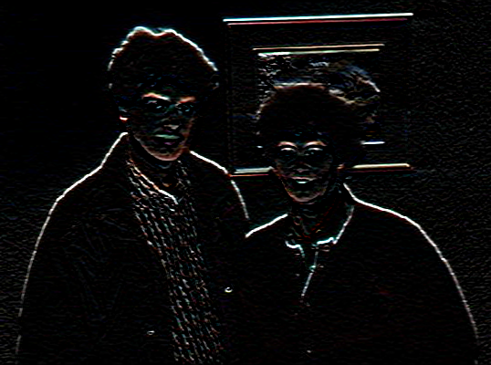
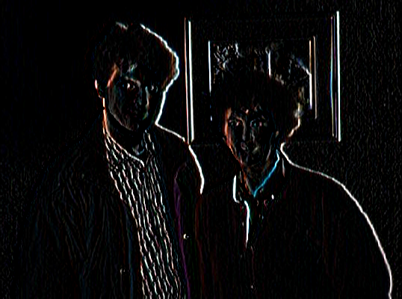
More e.g.’s
Horizontal Sobel
Vertical Sobel
1st derivative

Slide 58
Morphology
The science of form and structure
  the science of form, that of the outer form, inner structure, and development of living organisms and their parts
  about changing/counting regions/shapes
Used to pre- or post-process images
  via filtering, thinning and pruning
Smooth region edges
  create line drawing of face
Force shapes onto region edges
  curve into a square
Count regions (granules)
  number of black regions
Estimate size of regions
  area calculations

Slide 59
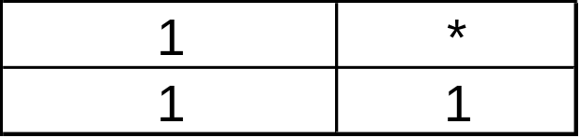
Morphological Principles
Easily visulaised on binary image
Template created with known origin
Template stepped over entire image
  similar to correlation
Dilation
  if origin == 1 -> template unioned
  resultant image is large than original
Erosion
  only if whole template matches image
  origin = 1, result is smaller than original

Slide 60
Dilation
Dilation (Minkowski addition)
  fills in valleys between spiky regions
  increases geometrical area of object
  objects are light (white in binary)
  sets background pixels adjacent to object's contour to object's value
  smoothes small negative grey level regions

Slide 61
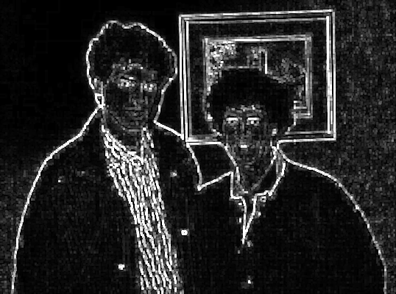
Dilation e.g.

Slide 62
Erosion
Erosion (Minkowski subtraction)
  removes spiky edges
  objects are light (white in binary)
  decreases geometrical area of object
  sets contour pixels of object to background value
  smoothes small positive grey level regions

Slide 63
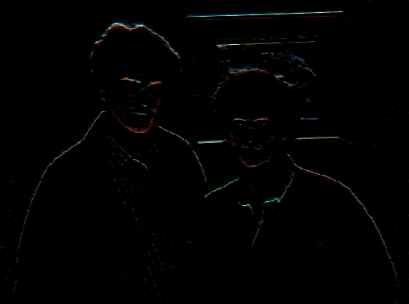
Erosion e.g.

Slide 64
Hough Transform
Intro
  edge linking & edge relaxation join curves
  require continuous path of edge pixels
  HT doesn’t require connected / nearby points
Parametric representation
  Finding straight lines
  consider, single point (x,y)
  infinite number of lines pass through (x,y)
  each line = solution to equation
  simplest equation:
    y = kx + q

Slide 65
HT - parametric representation
y = kx + q
  (x,y) - co-ordinates
  k - gradient
  q - y intercept
Any stright line is characterised by k & q
  use : ‘slope-intercept’ or (k,q) space not (x,y) space
  (k,q) - parameter space
  (x,y) - image space
  can use (k,q) co-ordinates to represent a line

Slide 66
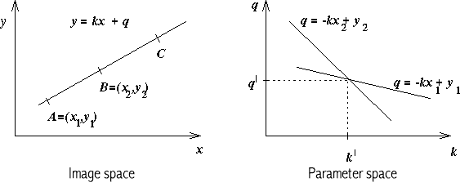
Parameter space
q = y - kx
  a set of values on a line in the (k,q) space == point passing through (x,y) in image space
  OR
  every point in image space (x,y) == line in parameter space

Slide 67
HT properties
Original HT designed to detect straight lines and curves
Advantage - robustness of segmentation results
  segmentation not too sensitive to imperfect data or noise
  better than edge linking
  works through occlussion
Any part of a straight line can be mapped into parameter space

Slide 68
Accumulators
Each edge pixel (x,y) votes in (k,q) space for each possible line through it
  i.e. all combinations of k & q
This is called the accumulator
If position (k,q) in accumulator has n votes
  n feature points lie on that line in image space
Large n in parameter space, more probable that line exists in image space
Therefore, find max n in accumulator to find lines

Slide 69
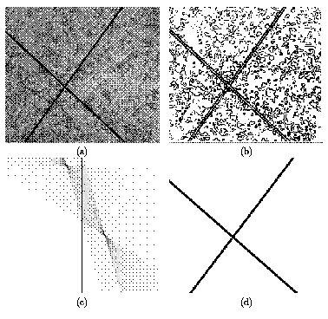
HT Algorithm
Find all desired feature points in image space
  i.e. edge detect (low pass filter)
Take each feature point
  increment appropriate values in parameter space
  i.e. all values of (k,q) for give (x,y)
Find maxima in accumulator array
Map parameter space back into image space to view results

Slide 70
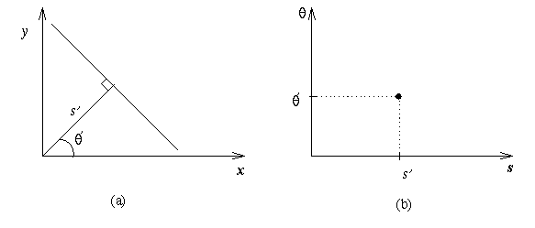
Alternative line representation
‘slope-intercept’ space has problem
  verticle lines k -> infinity q -> infinity
Therefore, use (ρ,θ) space
  ρ = xcos θ + y sin θ
  ρ = magnitude
  drop a perpendicular from origin to the line
  θ = angle perpendicular makes with x-axis

Slide 71
ρ,θ space
In (k,q) space
  point in image space == line in (k,q) space
In (ρ,θ) space
  point in image space == sinusoid in (ρ,θ) space
  where sinusoids overlap, accumulator = max
  maxima still = lines in image space
Practically, finding maxima in accumulator is non-trivial
  often smooth the accumulator for better results

Slide 72
HT for Circles
Extend HT to other shapes that can be expressed parametrically
Circle, fixed radius r, centre (a,b)
  (x₁-a)² + (x₂-b)² = r²
  accumulator array must be 3D
  unless circle radius, r is known
  re-arrange equation so x₁ is subject and x₂ is the variable
  for every point on circle edge (x,y) plot range of (x₁,x₂) for a given r

Slide 73
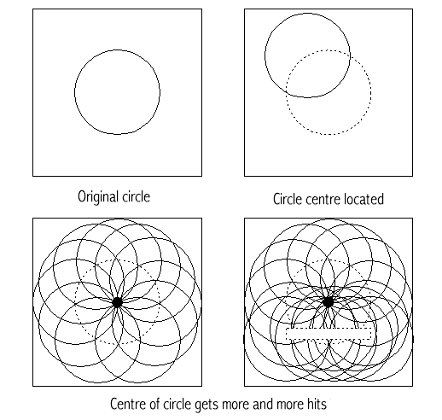
Hough circle example

Slide 74
General Hough Properties
Hough is a powerful tool for curve detection
Exponential growth of accumulator with parameters
Curve parameters limit its use to few parameters
Prior info of curves can reduce computation
  e.g. use a fixed radius
Without using edge direction, all accumulator cells A(a) have to be incremented

Slide 75

Optimisation HT
With edge direction
  edge directions quantised into 8 possible directions
  only 1/8 of circle need take part in accumulator
Using edge directions
  a & b can be evaluated from
  θ = edge direction in pixel x
  delta θ = max anticipated edge direction error
Also weight contributions to accumulator A(a) by edge magnitude

Slide 76
General Hough
Find all desired points in image
For each feature point
  for each pixel i on target boundary
    get relative position of reference point from i
    add this offset to position of i
    increment that position in accumulator
Find local maxima in accumulator
Map maxima back to image to view

Slide 77
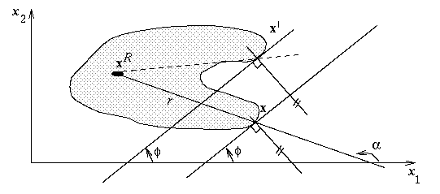
General Hough example
explicitly list points on shape
make table for all edge pixles for target
for each pixel store its position relative to some reference point on the shape
‘if I’m pixel i on the boundary, the reference point is at ref[i]’

